Slide 1


Session // 02 ARTIFICIAL NEURAL NETWORKS FACULTY OF SCIENCE AND ENGINEERING +++
Diego Corona Lopez – AI Technical Specialist

Slide 2
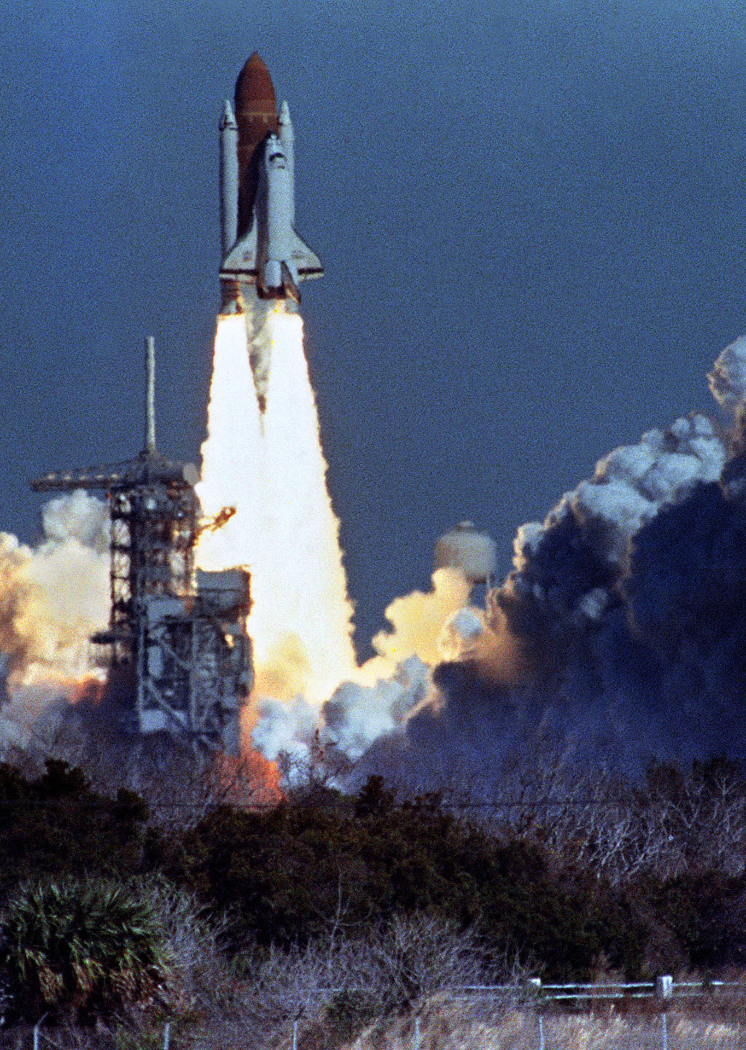
Agenda
Introduction to Artificial Neural Networks
Understanding neural networks and their components
Exploring neuron structure and activation functions
Implementing a Neuron in PyTorch
Hands-on coding: Building a perceptron model
Exercise: Creating our first neural network component
Case Study: Space Shuttle Challenger
Historical context of the disaster
Introduction to the O-ring dataset
Data Preparation and Model Design
Exercise: Preprocessing temperature and O-ring data
Converting, normalizing and structuring data for neural networks
Training and Evaluation
Exercise: Implementing loss functions and model training
Visualizing model performance and understanding convergence
Risk Analysis and Ethical Implications
Exercise: Predicting O-ring failure at Challenger launch temperature
Discussion: Data science ethics and responsibility

Slide 3
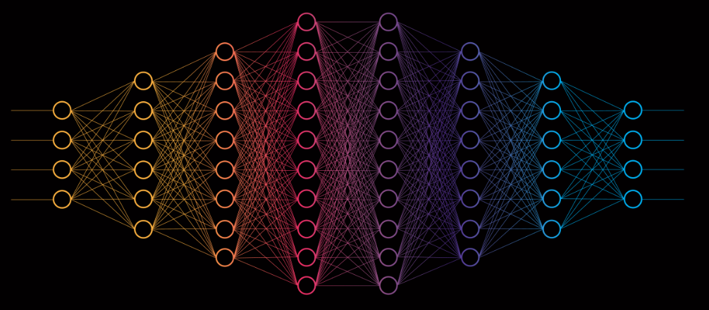
What Are Artificial Neural Networks?
ANNs are computational models inspired by the human brain's neural structure. They consist of interconnected neurons organized in layers that transform input data into meaningful outputs. Each neuron performs weighted calculations on its inputs and applies an activation function to introduce non-linearity.

Slide 4
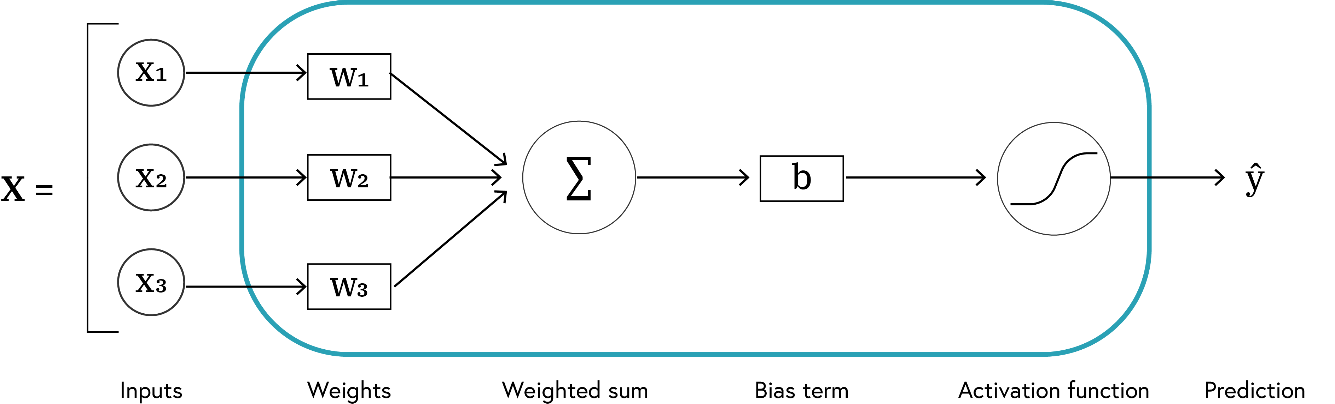

Anatomy of a Neuron
Basic computational units of neural networks
Each neuron:
Receives inputs
Applies weights and bias
Processes through activation function
Produces output
$$\hat{y}=f\left(W⋅X+b\right)$$

Slide 5
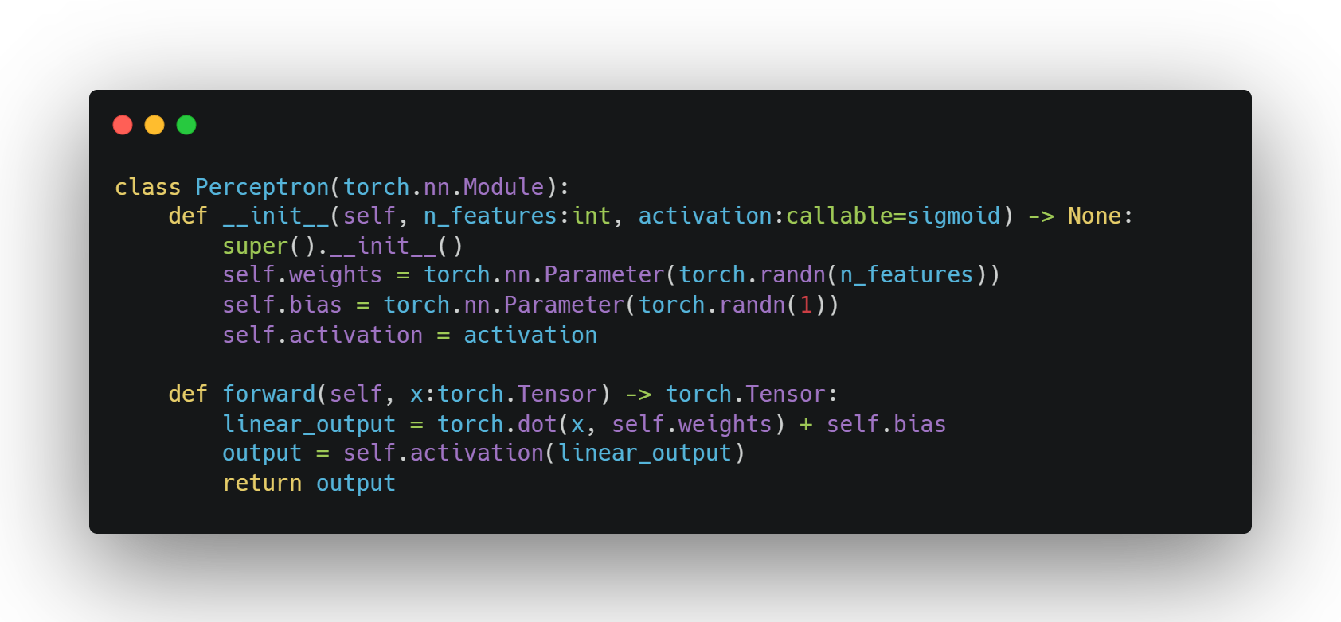
Implementing a Neuron
SE02
05

Slide 6
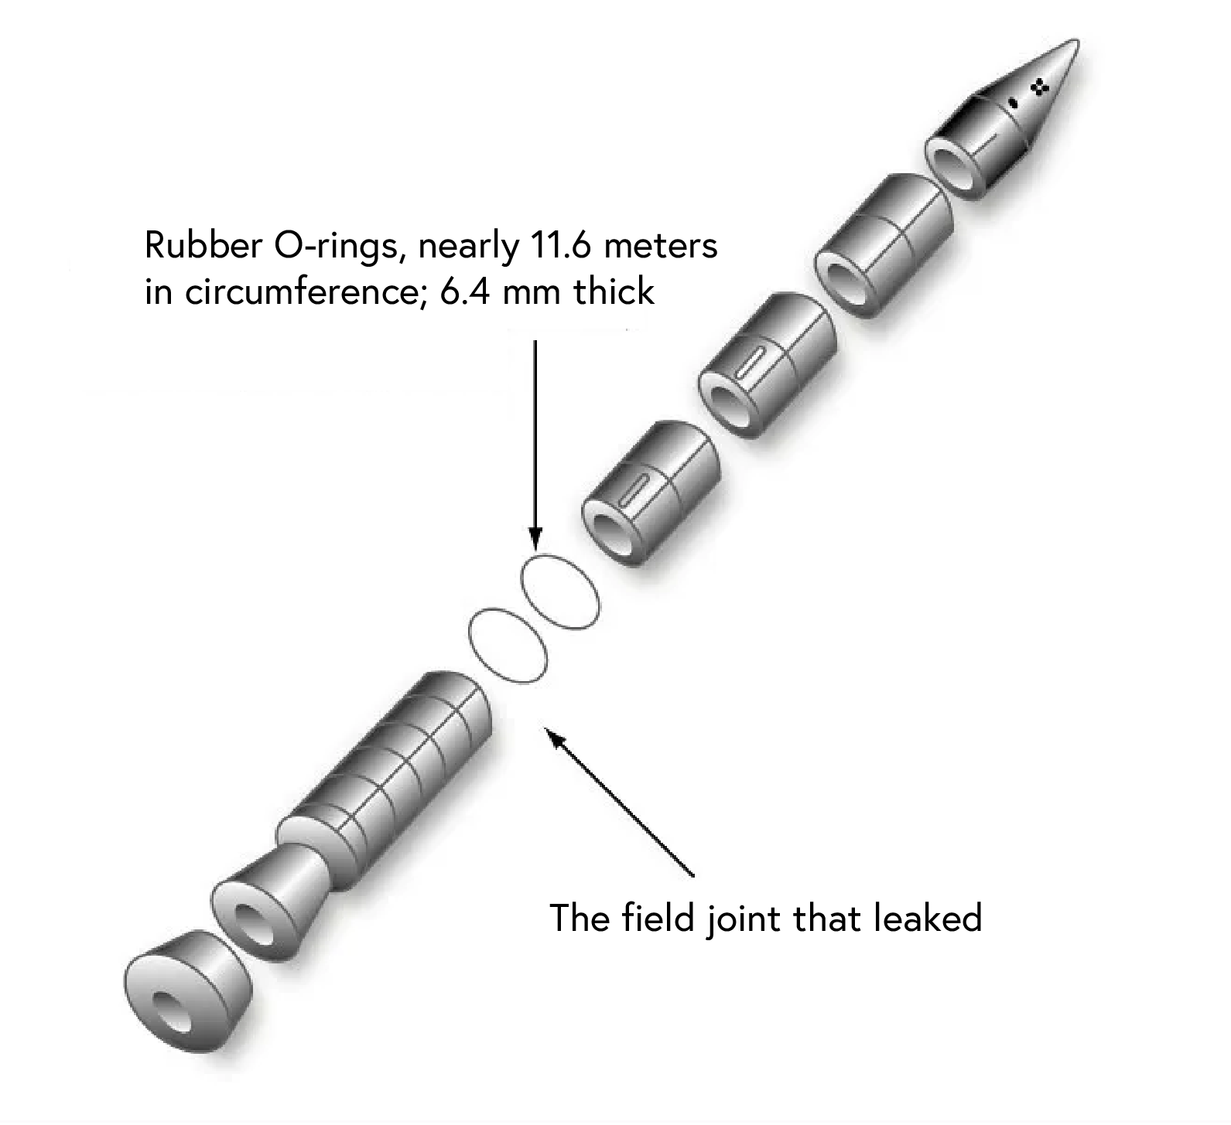
The Space Shuttle Challenger Disaster
January 28, 1986: Space Shuttle Challenger exploded 73 seconds after launch
Cause: O-ring failure due to low temperatures
Question: Could data analysis have prevented this tragedy?

Slide 7
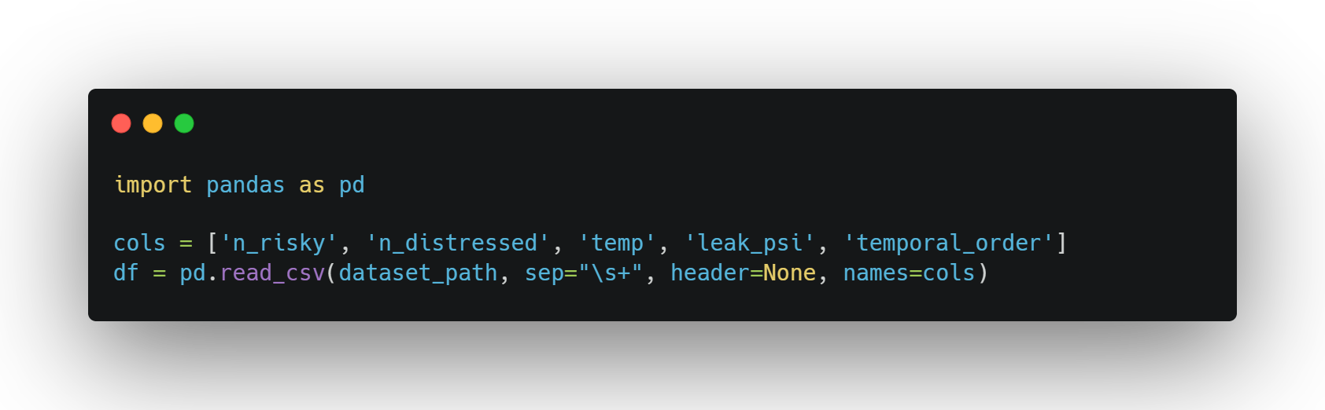
O-RING
FAILURE DATAset
Historical data from previous shuttle launches
Key variables:
Temperature at launch (°F)
Number of O-rings at risk
Number of O-rings experiencing thermal distress
SE02
07

Slide 8
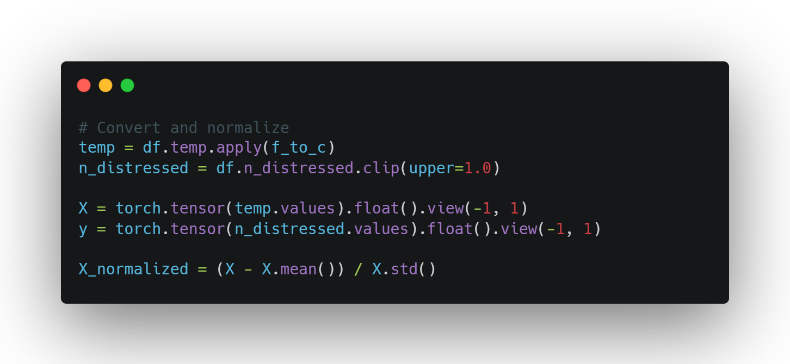
DATA
PREPARATION
Convert temperature from Fahrenheit to Celsius
Convert distress to binary outcome (0 or 1)
Normalize temperature data
Split into training and test sets
SE02
08

Slide 9
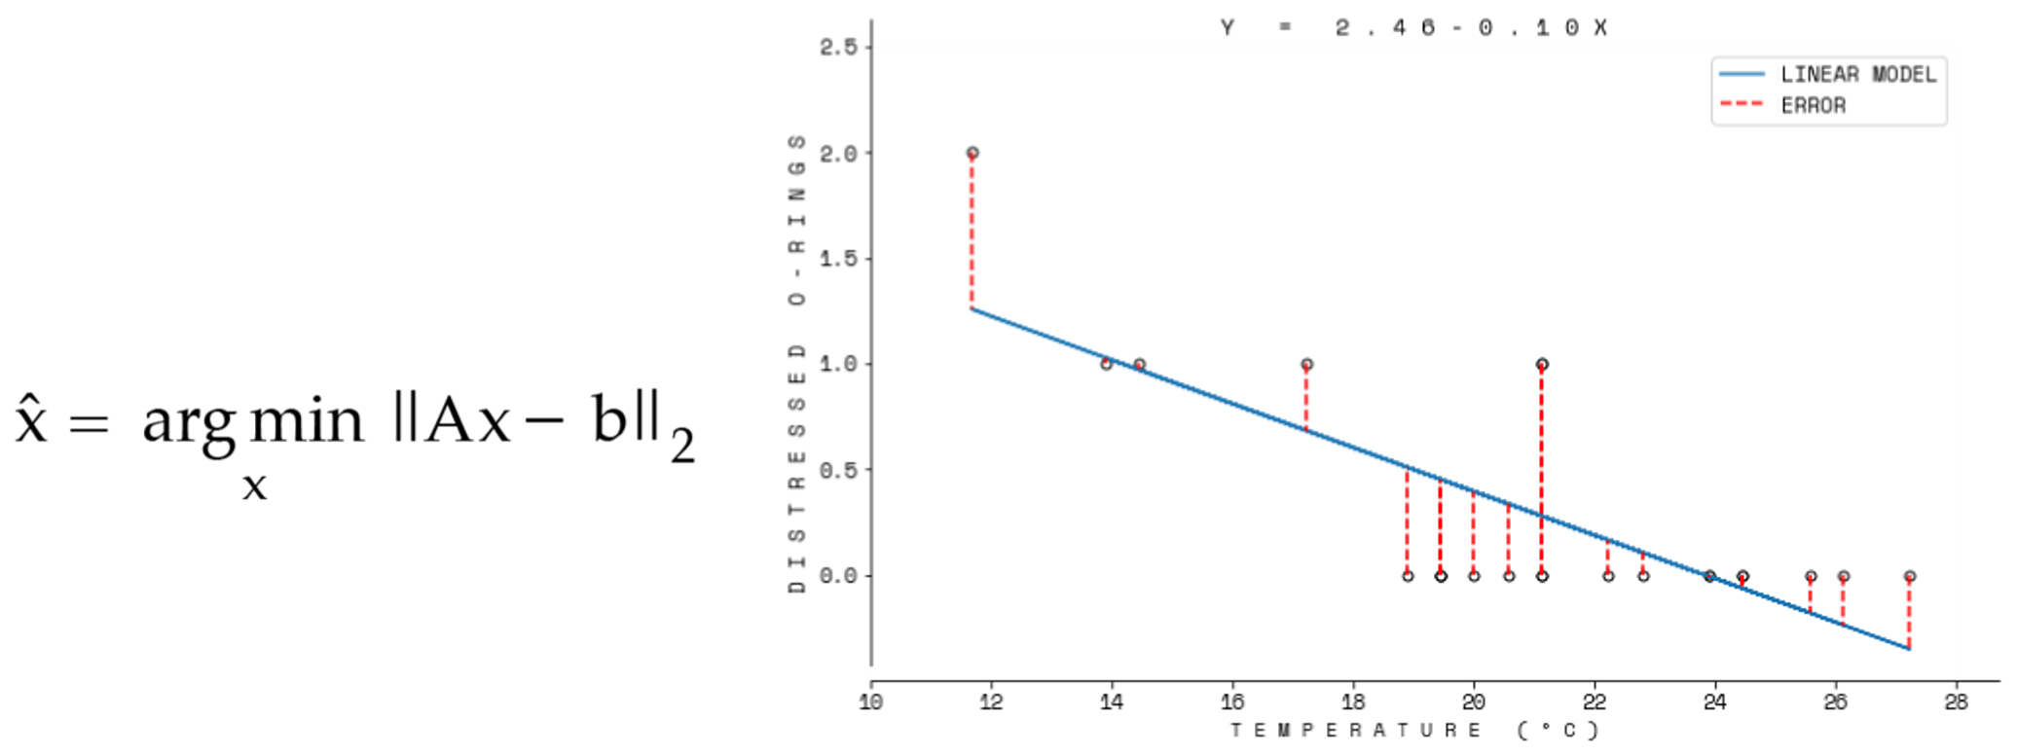
BASICS OF TRAINING
Forward Pass: Feed data through network to get predictions
Loss Calculation: Measure error between predictions and targets
Backward Pass: Compute gradients to adjust parameters
Parameter Update: Improve model using gradient descent
SE02
09

Slide 10
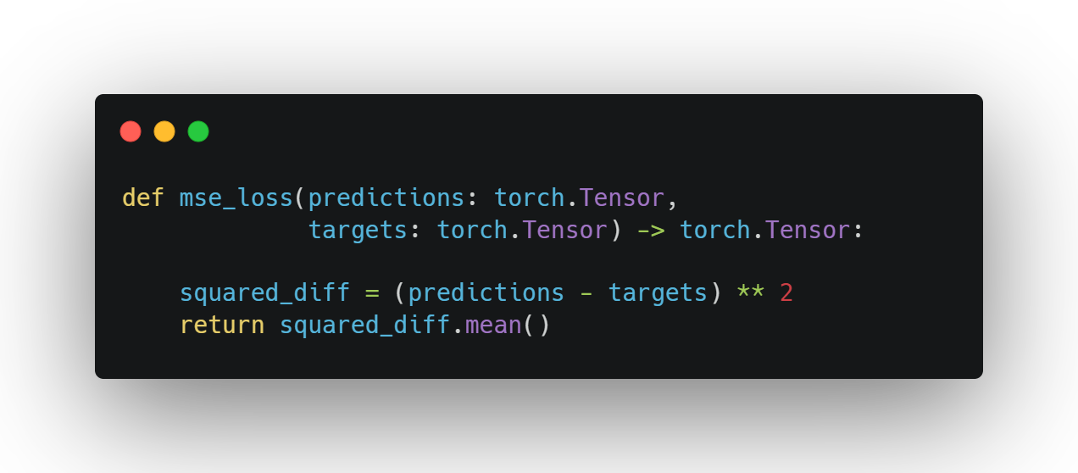
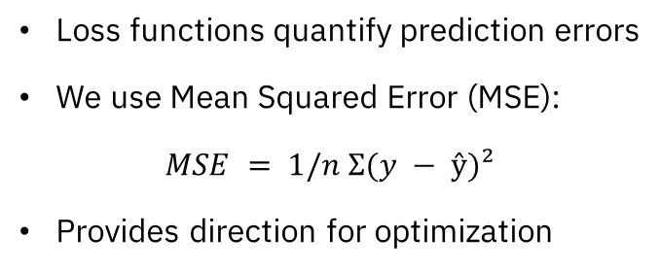
Loss function
Loss functions quantify prediction errors
We use Mean Squared Error (MSE):
$MSE = 1/n Σ(y − ŷ)²$
Provides direction for optimization
SE02
10

Slide 11
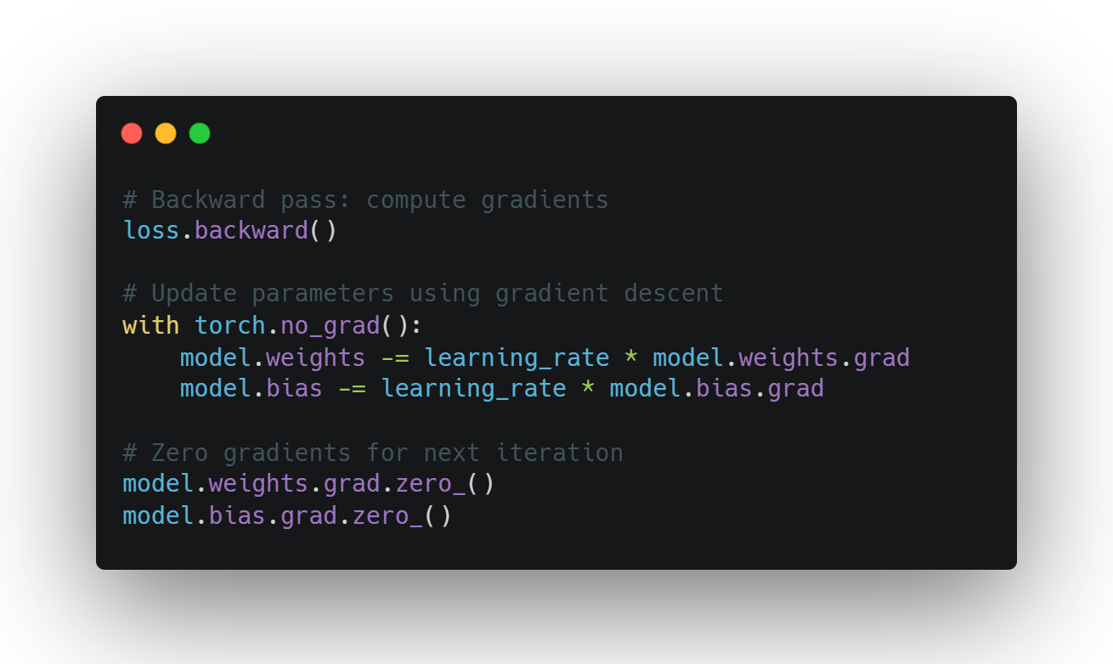
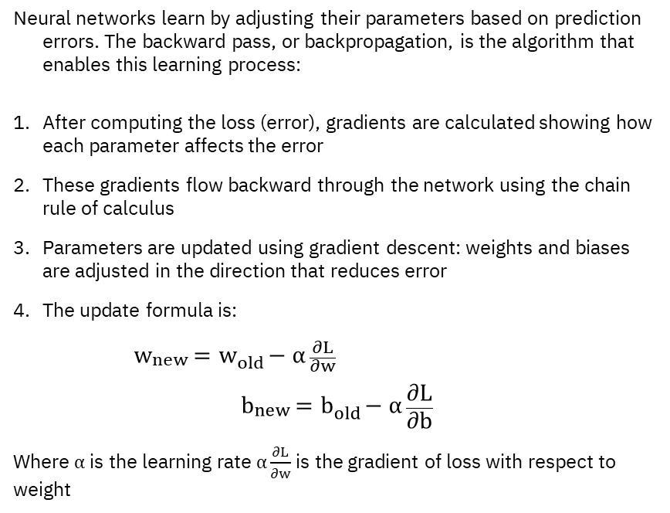
Backward
Propagation
Neural networks learn by adjusting their parameters based on prediction errors. The backward pass, or backpropagation, is the algorithm that enables this learning process:
After computing the loss (error), gradients are calculated showing how each parameter affects the error
These gradients flow backward through the network using the chain rule of calculus
Parameters are updated using gradient descent: weights and biases are adjusted in the direction that reduces error
The update formula is:
$w_{new}=w_{old}−α\frac{∂L}{∂w}$
$$b_{new}=b_{old}−α\frac{∂L}{∂b}$$
Where $α$is the learning rate $α\frac{∂L}{∂w}$is the gradient of loss with respect to weight
SE02
11

Slide 12
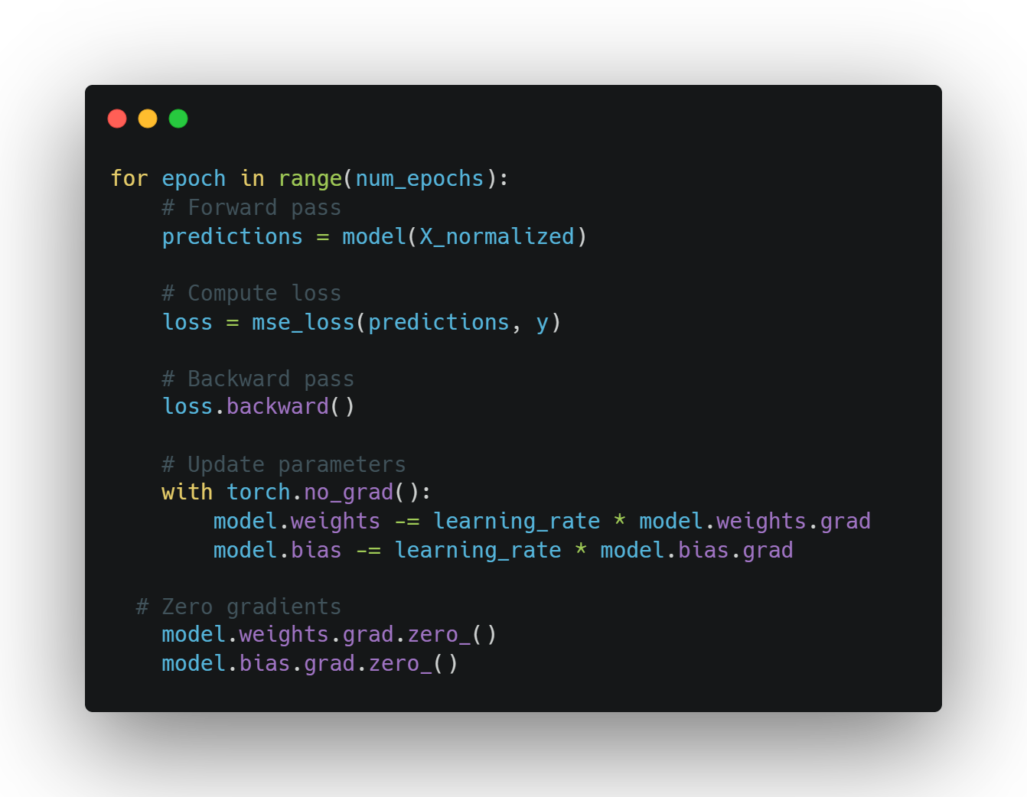
TRAINING
Set learning rate and number of epochs
Perform forward pass, loss calculation, backward pass, parameter update
Monitor training progress
SE02
12

Slide 13
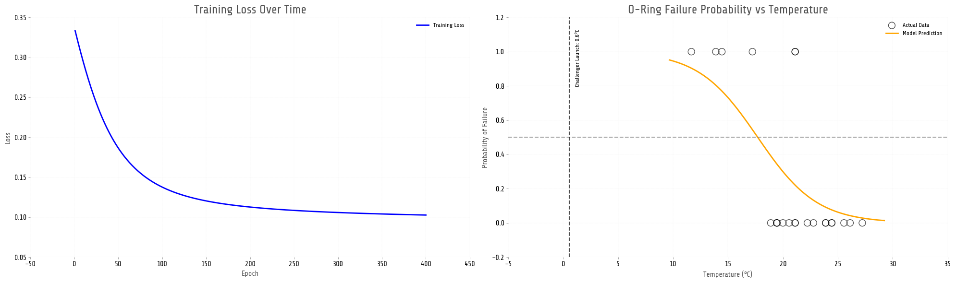
TRACKING RESULTS
Loss decreases over time (model improves)
Model captures relationship between temperature and O-ring failure
SE02
13

Slide 14
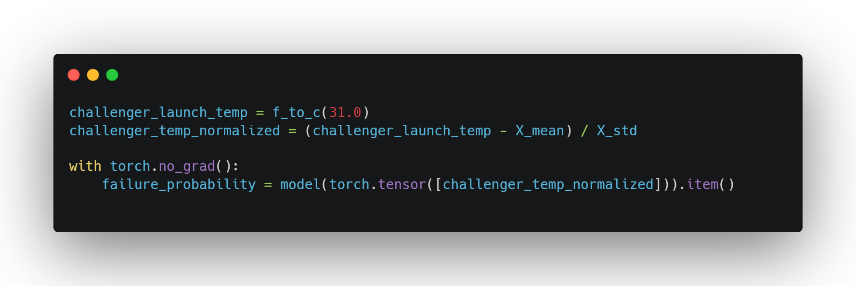
PREDICTING
LAUNCH RISK
Challenger launch temperature: 31°F (-0.56°C)
Model prediction: 99.9% probability of O-ring failure
Comparison: Risk at launch temperature is 3.3X times higher than at normal temperature
SE02
14

Slide 15
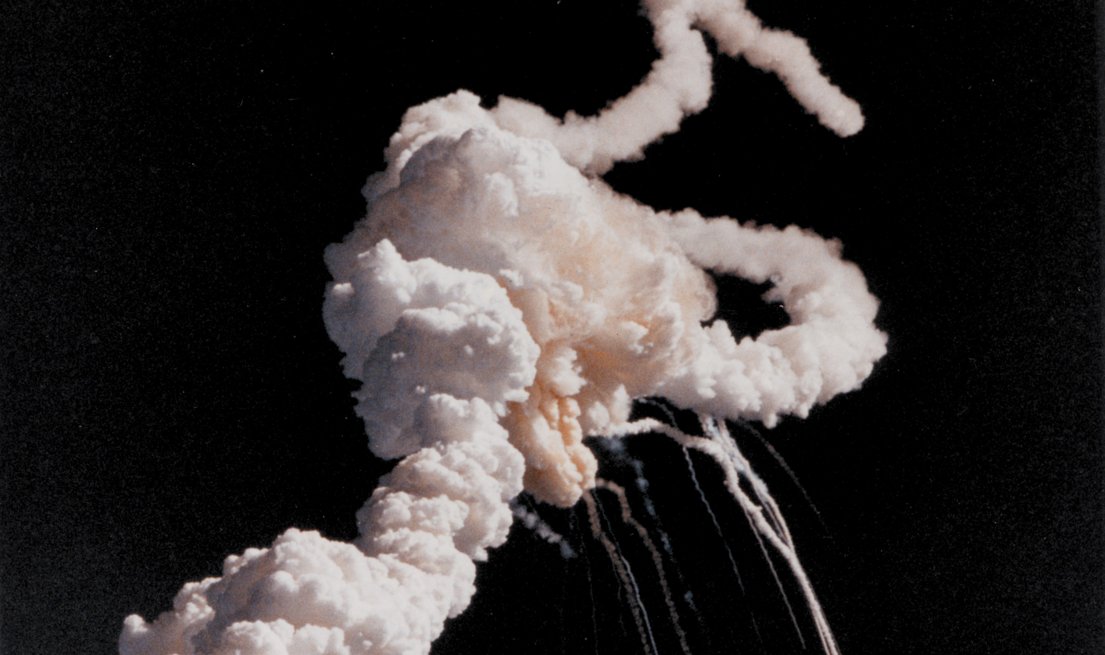
Ethical Implications
Lives depend on accurate data analysis and interpretation
Responsibility to thoroughly analyse data and clearly communicate risks
Technical findings must be presented in ways decision-makers can understand
Question: How can we ensure data insights are properly considered in critical decisions?

